Slide 1
Tautoko Rā Kaiako
Te Whakahou i Te Marautanga o Aotearoa
Tua Rua : Whiringa-ā-rangi 2023

Slide 2


Te Whakahou i Te Marautanga o Aotearoa
In Teacher Only Day 2, you will have the opportunity to increase your understanding and ability to use the four pou in your teaching and learning programs.
We now refer to the four pou as 'Nga Pou Matua o te Tīrewa Marautanga'. There has also been an intentional shift to refer to 'te tamaiti' as 'te mokopuna', which you will see reflected in the titles of the four pou.
Key messages: Engage with key messages
Wānanga 1: Revisit TOD 1 and the four pou
Wānanga 2: Te Mokopuna Hei Ākonga
Wānanga 3: Te Mokopuna Hei Tangata
Wānanga 4: Te Mokopuna Hei Puna Kōrero
Wānanga 5: Te Mokopuna Hei Uri Whakaheke
Wānanga 6: Ngā Pou Matua and your kura

Slide 3
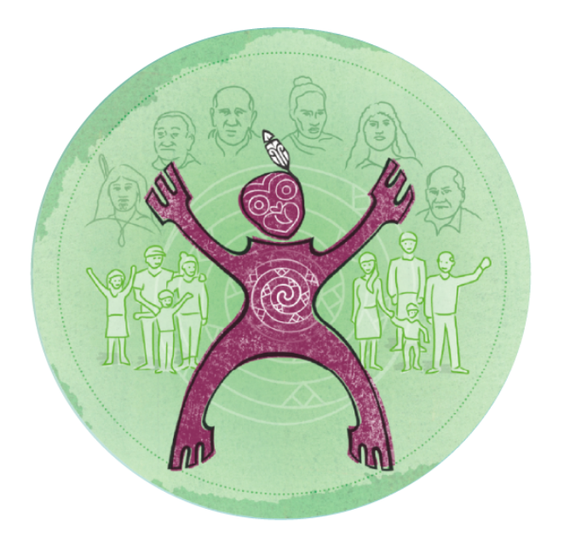
Key Messages
Te Tīrewa Marautanga o Aotearoa (Te Tīrewa Marautanga) is the title for the redesigned national curriculum.
The whakaaro of Ngā Pou Matua o Te Tīrewa Marautanga has been lifted from Te Tamaiti Hei Raukura paper.
Ngā Pou Matua form the foundation of Te Tīrewa Marautanga and reflect the aspirations whānau, hapū and iwi have for their tamariki and mokopuna. (Watch Angitu video on next slide)
The pou also highlight the holistic nature of learning and of the ākonga. All areas of learning address each pou in some way. One pou may be more prominent in a particular kaupapa.
This collection of resources is designed to support the further exploration and familiarisation of the four pou and to consider the implications for teaching, learning and aromatawai.

Slide 4


Slide 5
Wānanga 1
Revisit TOD 1 resources and activities.
Ngā Pou
Watch this video that explains some of the attributes and concepts associated with each of Ngā Pou.

Slide 6
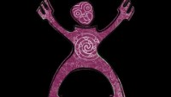
Notes:
Video credits: Kia Ata Mai

Slide 7

Wānanga 2
Te Mokopuna Hei Ākonga
Read the description of this Pou Matua and work through the wānanga suggestions.

Slide 8

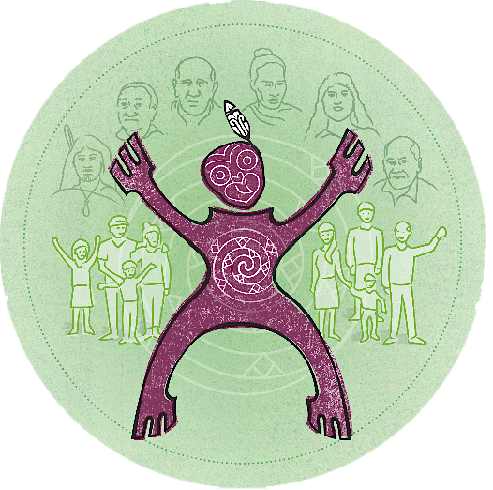
Te Mokopuna hei ākonga is one of the four Pou Matua from
Te Tīrewa Marautanga.
This Pou Matua refers to the mokopuna as:
    a learner
    a thinker
    an innovator,
    a problem-solver
    a risk-taker
    a contributor and creator to the world they live in now and in the future.
Hei wānanga:
How do you define each of these capabilities within your kura?
How do you recognise and monitor these capabilities from mokopuna during learning experiences?
How do we support the mokopuna to progress their learning?
What are the mokopuna skills, knowledge and actions you would see in this Pou?
Kia matatau te mokopuna ki ngā tini mata o te ako

Slide 9

Wānanga 3
Te Mokopuna Hei Tangata
Read the description of this Pou Matua and work through the wānanga suggestions.

Slide 10
Te Mokopuna hei tangata is one of the four Pou Matua from Te Tīrewa Marautanga.
This Pou Matua refers to the mokopuna as:
  a thinking and caring human being
  socially confident and emotionally aware
  healthy in mind, body, and spirit guided by
  values and attitudes that enable
      positive participation in the world and
      respectful engagement with others.
Hei wānanga:
How do you define each of these capabilities within your kura?
How do you recognise and monitor these capabilities from mokopuna during learning experiences?
How do we support the mokopuna to progress their learning?
What are the mokopuna skills, knowledge and actions you would see in this Pou?
Kia puāwai ngā tini mata o te pūmanawa tāngata

Slide 11
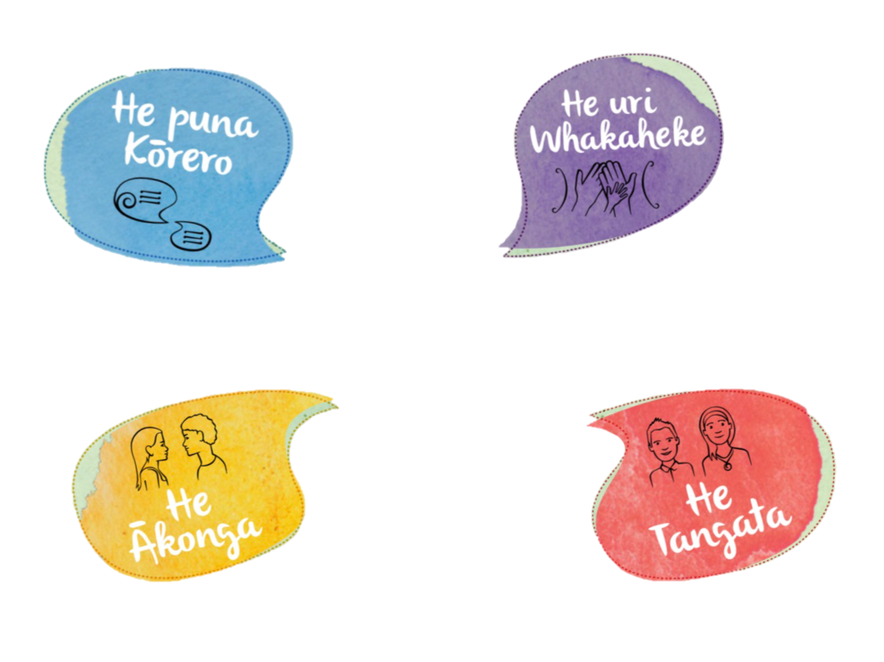
Wānanga 4
Te Mokopuna Hei Puna Kōrero
Read the description of this Pou Matua and work through the wānanga suggestions.

Slide 12
Te Mokopuna hei puna kōrero is one of the four Pou Matua from Te Tīrewa Marautanga.
This Pou Matua refers to the mokopuna as:
  a proficient communicator, engager, and evaluator of ideas
  able to articulate their thoughts, opinions, feelings, and understandings
  confident users of a range of literacies.
Hei wānanga:
How do you define each of these capabilities within your kura?
How do you recognise and monitor these capabilities from mokopuna during learning experiences?
How do we support the mokopuna to progress their learning?
What are the mokopuna skills, knowledge and actions you would see in this Pou?
Kia matatau te tamaiti ki ngā tini mata o te reo

Slide 13

Wānanga 5
Te Mokopuna Hei Uri Whakaheke
Read the description of this Pou Matua and work through the wānanga suggestions.

Slide 14
Te Mokopuna hei uri whakaheke is one of the four Pou Matua from Te Tīrewa Marautanga.
This Pou Matua refers to the mokopuna as:
  a culturally confident contributor to the world they live in
  mokopuna, as representatives of their whānau, hapū and iwi
  as recipients, holders, sharers, and creators of valued learning handed down through the generations
Hei wānanga:
How do you define each of these capabilities within your kura?
How do you recognise and monitor these capabilities from mokopuna during learning experiences?
How do we support the mokopuna to progress their learning?
What are the mokopuna skills, knowledge and actions you would see in this Pou?
Kia tau te tamaiti i roto i ngā tini mata o te tuakiri

Slide 15
Wānanga 6
Ngā Pou Matua and your kura
From the insights you have gained in this series of wānanga discuss the following questions.

Slide 16
Ngā Pou Matua in your kura
All four Pou Matua discussed in the previous wānanga form the tūāpapa of Te Tīrewa Marautanga.
From the insights you have gained in this series of wānanga discuss the following questions:
Hei Wānanga :
He aha ngā āhuatanga ka kite koe e whakaata mai ana i tō ake kura?
He pēhea koe e tuitui i ngā āhuatanga o ngā pou e whā ki roto ki ō kaupapa whakaako, ako hoki?
He āhuatanga ako atu, ako mai hoki kāore i whakapuakina i roto i ngā pou e whā?
He aha ngā rerekētanga, mehemea he rerekētanga, ka mate koe ki te mahi?
He aha te momo tautoko ka hiahiatia e koe kia whakamanahia ai ēnei rerekētanga?

Slide 17
He aha e whai ake nei?
23 October - 1 December 2023
We will be delivering Regional workshops to introduce the elements within Te Tīrewa Marautanga o Aotearoa, and to seek your feedback on the direction of the redesign.
Term 1 & Term 2 2024
Regional workshops will continue socialising Te Tīrewa Marautanga o Aotearoa.
We will be testing the first drafts of Te Reo Māori and Pāngarau, Te Ao Māori and Pūmanawa Tangata.
Mō ētahi atu mōhiohio me haere ki tā mātou whārangi Te Whakahou i Te Marautanga o Aotearoa
Tēnā, tuarihia te katoa o ngā urupare kia taea ai e mātou te whakapai ake ngā ihirangi ka whakawāteahia ai mō te Tautoko Rā Kaiako e whai ake nei tukuna ki TeReo.MaoriGroup@education.govt.nz

